Slide 1
Software Design and Analysis CS-3004
Dr. Javaria Imtiaz,
Mr. Basharat Hussain,
Mr. Majid Hussain

Slide 2
Outline
Introduction to the Course
Course Objectives
Why this course is important for you?
Course Contents and Structure
Course Project

Slide 3
About Dr. Javaria Imtiaz
Assistant Professor
PhD(SE) – FAST-NUCES (2021)
Full Funded Scholarship
Research Associate – Quest UAV Dependability Lab (2018-current)
Professional Trainer of SCM, Web Test Automation, DevOPs
Over 9 years of Industry and Academia experience
Expertise: Web Test automation, Software Testing , Web application product lines, Java (SE & EE), UML, Model-driven Software Engineering, DevOPs.
MS(SE) – FAST-NUCES (2015-2017)
Full Funded Scholarship
Distinction
Instructor – FAST-NUCES (2014-2018)
BS(SE) – IIUI (2010-2014)

Slide 4
About Mr. Basharat Hussain
Lecturer
PhD(CS) – COMSATS (In-progress)
Over 24 years of Industry and Academia experience
Expertise: .NET, Programming, Design and Architecture, Software Testing , product lines, UML, Model-driven Software Engineering, DevOPs
MS(CS) – IIUI (2014-2016)
Distinction
Instructor – COMSTAS, RIPHAH, FAST-NUCES

Slide 5
About Mr. Majid Hussain

Slide 6

Contact Details
Dr. Syeda Javaria Imtiaz
Email: javaria.imtiaz@nu.edu.pk
Office: Room (205-B, 2nd Floor Computer Science Block C)
Mr. Basharat Hussain
Email: basharat.hussain@nu.edu.pk
Office: Room (209-D, 2nd Floor Computer Science Block A)
Mr. Majid Hussain
Email: majid.hussain@nu.edu.pk
Office: Room (304-C, 3nd Floor Computer Science Block C)
Miscellaneous
Office Hours: Will be Displayed outside my office.
2 Classes of 1.5 hours

Slide 7
Lecture Format
Start with Q & A
Main Lecture
No short breaks in the middle
Practice sessions on various case studies
Designing/Modelling of software artifacts
Translation of design artifacts into code

Slide 8
Why this course is important for you?
Almost every large and complex industrial project follow a detailed design.
Every safety critical system must be well designed according to their safety standards.
Industry hire requirement analysts and software designers to model the ongoing projects.
Design artifacts carry a major weightage in FYP.

Slide 9
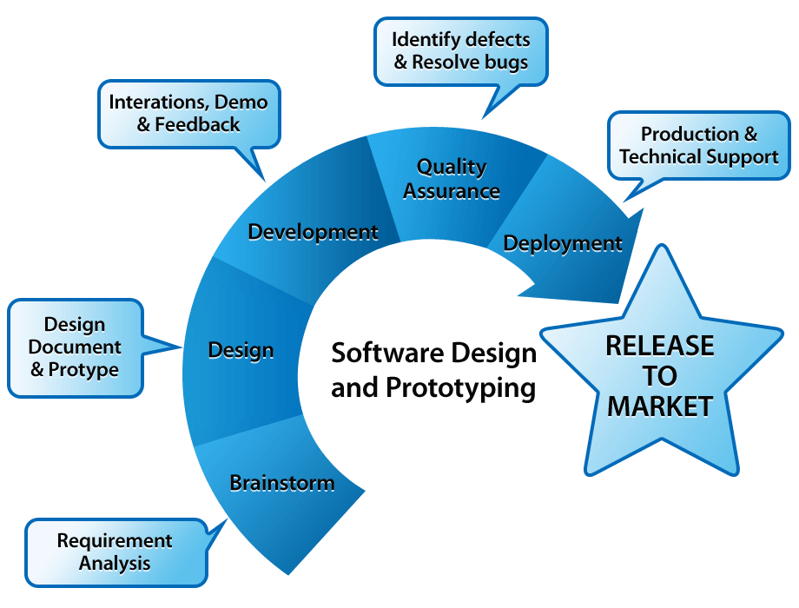
Software Development Process

Slide 10
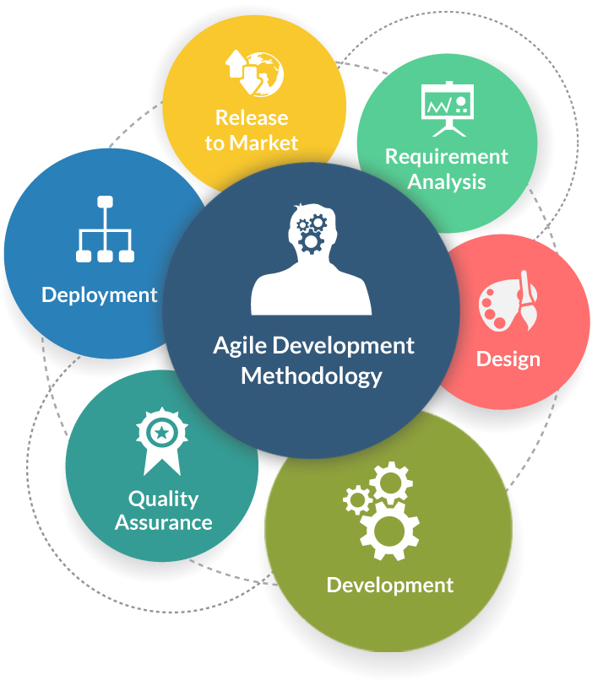
Software development Methodologies
frequent alteration in the development project
minimize risk by developing software in short time boxes
changing requirements of the clients.
Notes:
Reference link: https://www.tatvasoft.com/blog/top-12-software-development-methodologies-and-its-advantages-disadvantages/

Slide 11
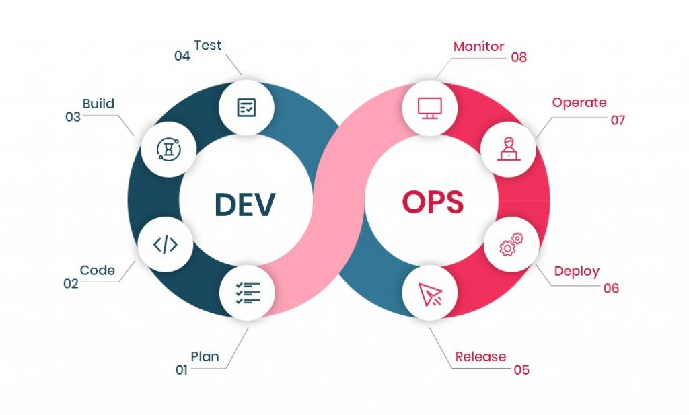
Cont..
Follow continuous integration and continuous delivery model
development and operational teams to perform everything simultaneously in development, quality assurance, security, and other operations.
It makes the process faster and easier for businesses to process on time

Slide 12
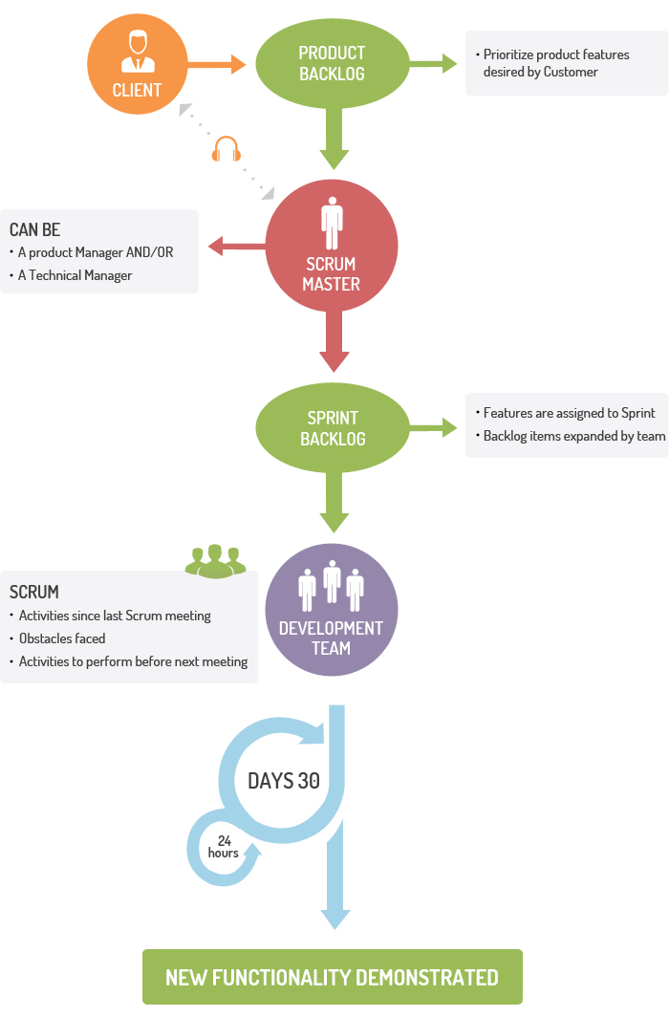
Cont..
For companies where the requirements are highly emerging and rapid changes are easily adhered to.
daily meeting easily helps the developer to make it possible to measure individual productivity.
Due to short sprints and constant feedback, it becomes easier to cope with the changes

Slide 13
Introduction to the Course
A major engineering problem today
Predictable development of reliable software systems.
The object-oriented paradigm
solutions to many development problems
provides a reliable design, complexity control, and reusability
Object-oriented methods can be divided into analysis and design, implementation languages, and distribution
Basic to the entire enterprise, however, are analysis and design, which has remained remarkably stable for years.
Object-Oriented Analysis and Design
overall goals of the object paradigm, the selection of classes, the relationships among them, and their realization to implement systems
Notes:
Software reliability is the probability of failure-free operation of a computer program for a specified period in a specified environment

Slide 14
Introduction to the Course
Object-Oriented Analysis and Design
Concepts and techniques necessary to effectively use system requirements to drive the development of a robust OO design model
Unified Modeling Language (OOAD/UML) 2.2
Focus on training by applying UML 2.2 notation to fundamental OOAD concepts including architecture, objects, classes, components, subsystems, stereotypes, relationships, and supporting diagrams.
Implementation

Slide 15
Traditional Software Development Flow
When a software developer begins work with a new project, it's natural for him to choose to commence scripting the code immediately.
Regardless of his software knowledge, if someone produces software without laying out a strategy for it, he might as well have been laying bricks without establishing a solid foundation.
The building will fall no matter how robust the construction process and resource consumption are; similarly, the software would fail without a fundamental layout.
Nobody wants their efforts to be for waste because they didn't have a plan for them, right? That's where software design comes in, a mechanism that simplifies important software operations in a certain way.

Slide 16
What is Software Analysis?
Analysis emphasizes an investigation of the problem and requirements, rather than a solution.
For example, if a new online trading system is desired, how will it be used? What are its functions?
"Analysis" is a broad term, best qualified, as in requirements analysis (an investigation of the requirements) or object-oriented analysis (an investigation of the domain objects).

Slide 17
What is Software Design?
Design emphasizes a conceptual solution (in software and hardware) that fulfills the requirements, rather than its implementation.
For example, a description of a database schema and software objects.
Design ideas often exclude low-level or "obvious" details—obvious to the intended consumers.
Design can be implemented, and the implementation (such as code) expresses the true and complete realized design.

Slide 18
Useful analysis and design have been summarized in the phrase do the right thing (analysis), and do the thing right (design).

Slide 19

Course Objectives
At the end of the course students will be able to:
Analyze problems from an object-oriented perspective
Apply an iterative, use case-driven, architecture-centric process to the development of a robust design model
Use UML 2.2 to represent the design model that take advantage of OO concepts of such as abstraction, encapsulation, inheritance, and polymorphism
Create OO designs and implement in Java
Apply design considerations through the use of patterns
Implement a pilot iterative OO project that leverages all key concepts learned in the course

Slide 20
Course Structure
3 Credit Hour Course (More applied than you think)
No labs
Programming Language and Tools
Java
UML Case tools like Enterprise Architect, Papyrus etc.
Course Project
Vital and major component of the course
Group of (3) students
Weekly Task
Coding Tasks

Slide 21
Course Contents
Outline
Introduction to course and pedagogy
Logical architecture – 3 tier and N-tier architectures
Overview of OOP, OOAD and UML
Capturing User requirements via Use-Cases
Understanding problem domain-Domain Model
Analyzing actor actions – System sequence diagrams
Modeling dynamic software behavior using sequence diagrams
Design class diagrams
Designing for visibility (Mapping design to code)
Assigning roles and responsibilities using GRASP
Learning from industry experience – Gang of Four design patterns
Packaging and deploying software

Slide 22
Course Content
OOP Basics Three tier architecture Requirements elicitation Use cases | FIRST SESSION
Domain modeling Interaction modeling GRASP Behavior modeling Gang of four patterns | SECOND SESSION
Gang of four patterns Logical Architecture Design to code Software Development tools and configuration management | THIRD SESSION

Slide 23
Textbooks and Supplementary Reading List
Text Book(s)
Craig Larman, Applying UML and Patterns, 3rd edition, 2004.
Bernd Bruegge, Allen H. Dutoit, Object-Oriented Software Engineering, using UML, Patterns, and Java.
UML 2 Toolkit Published by Wiley Publishing, Inc.
UML 2.0, Documentation:www.rational.com
Additional Reading List
Unified Modeling Language: Superstructure, version 2.1.2, formal/07-11-02, OMG, www.omg.org
Available in the Library/E-Book

Slide 24
Some Rules
Raise your hand before asking any question
Don’t miss a class
No retakes (except for Mid or Final Exam)
Don’t “sleep” in the class
You might miss a quiz ☹
Avoid using mobile phone in the class
Above all, whatever you do, please do not disturb others

Slide 25
Attendance Policy
Attendance will be taken at the beginning of the lecture
80% attendance is mandatory
Students coming late will be marked as late
2 late arrivals are equal to an absent

Slide 26

Dishonesty, Plagiarism
All parties involved in any kind of cheating in (Quizzes, Assignments & Projects) will get ZERO in that exam
Plagiarism in midterm/ final exam may result in F grade in the course
Habitual cases will be awarded F

Slide 27
Google Classroom Code
y6dpncj

Slide 28
Evaluation Breakdown
Theory breakdown
Grading Policy
Absolute Grading
Notes:
Ass01: Use cases
Ass02: Domain Model+ SSD
Ass03: SD + class diagram
Best quizzes consideration
Project: Java (three tier architecture code )

Slide 29
Revision
Functional vs non-functional Requirements
Difference between Agile, DevOps, Scrum
What is software development life cycle?
What are the phases of SDLC?
What is SRS?
Difference between Analysis and Design?
What is reliability?

Slide 30



Software use during this course
UML (Designing/Modeling Standard)
Rational Software Architect (Modeling tool)
Eclipse IDE (Development IDE)

Slide 31
Unified Modeling Language
A de facto industry standard by the Object Management Group (OMG)
Standard language for specifying, visualizing, constructing, and documenting the artifacts of software systems, business modeling and other non-software systems.
The UML represents a collection of best engineering practices that have proven successful in the modeling of large and complex systems.
The UML is a very important part of developing object oriented software and the software development process.
The UML uses mostly graphical notations to express the design of software projects.
Using the UML helps project teams communicate, explore potential designs, and validate the architectural design of the software.
Notes:
The goal of the OMG was a common portable and interoperable object model with methods and data that work using all types of development environments on all types of platforms.

Slide 32
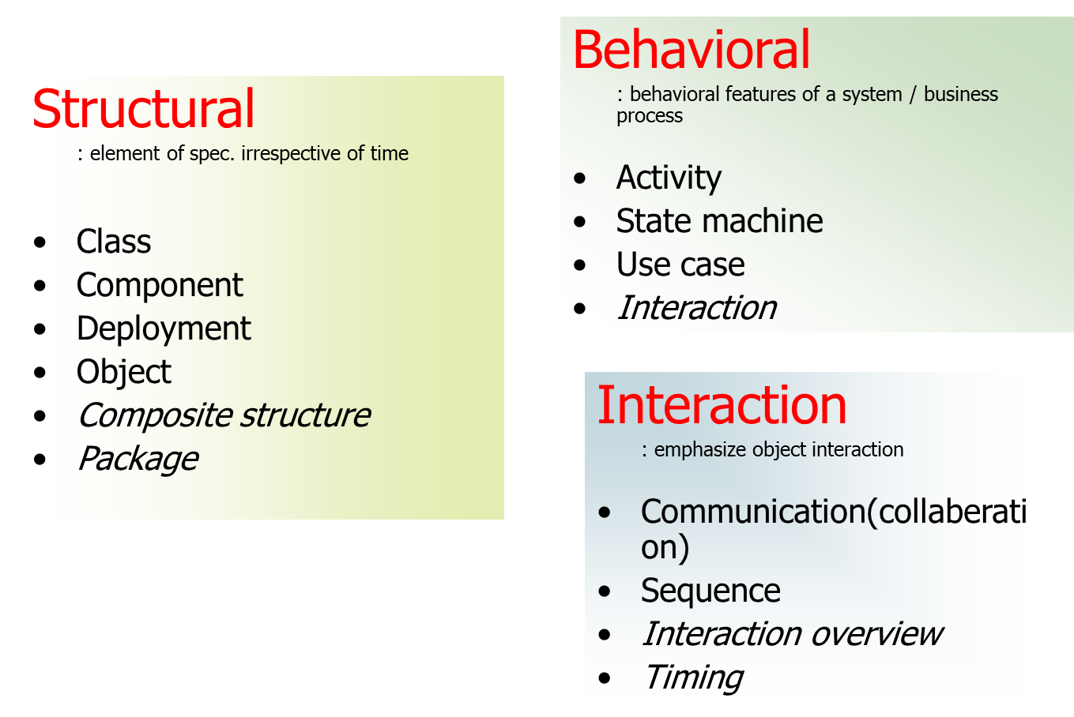
Overview of UML Diagrams
emphasizes the static structure of the system using objects, attributes, operations and relationships.
emphasizes the dynamic behavior of the system by showing collaborations among objects and changes to the internal states of objects.

Slide 33
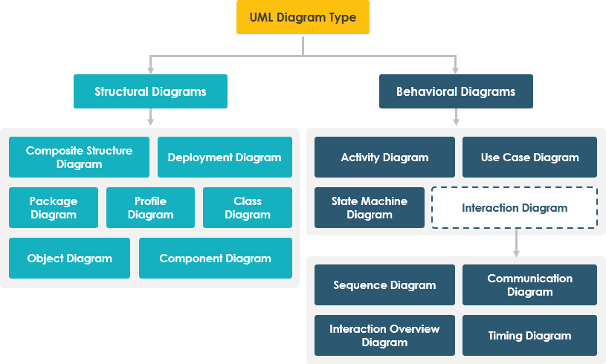

Slide 34
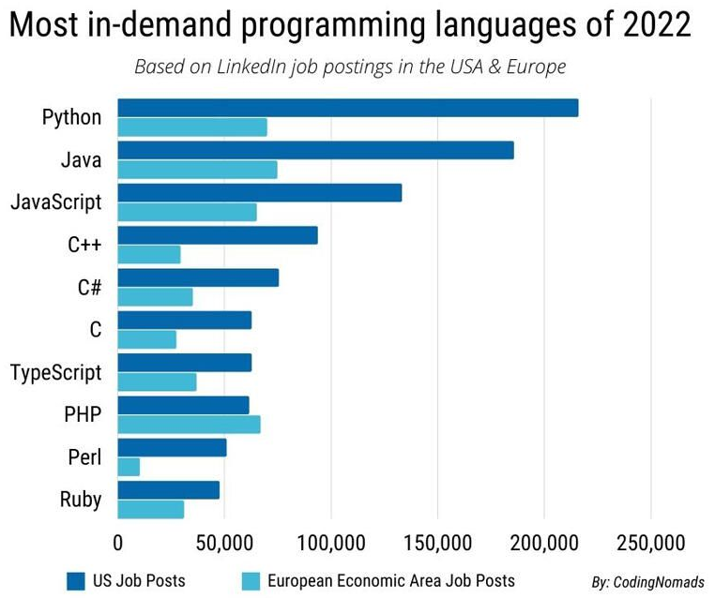
Why Java?
Notes:
JavaScript is a scripting language which helps you create interactive web pages.
TypeScript is an open-source pure object-oriented programing language. It is a strongly typed superset of JavaScript which compiles to plain JavaScript.
Ruby is great for building desktop applications, static websites, data processing services, and even automation tools. It's used for web servers, DevOps, and web scraping and crawling

Slide 35
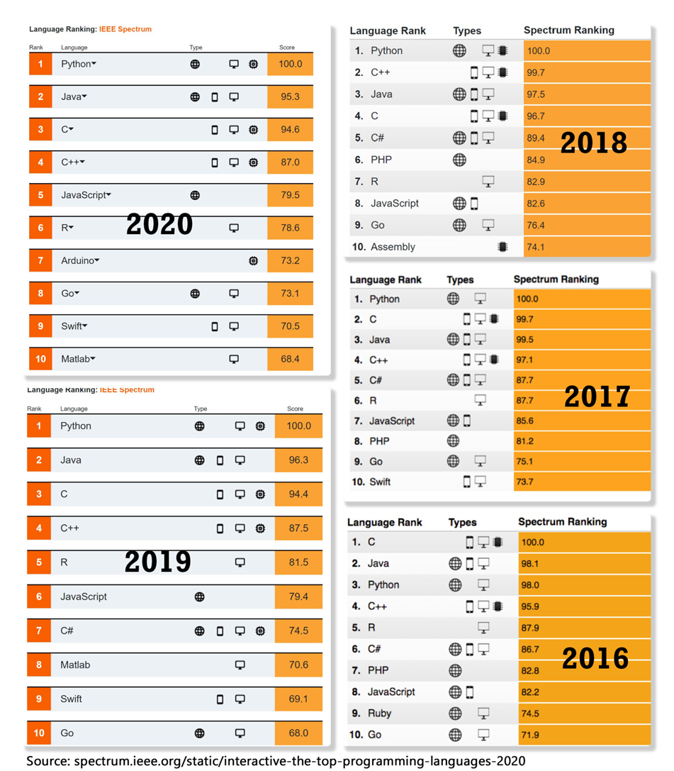
“Java is the main language behind Android, which owns an 85% share of the mobile market. It’s also the most popular language for Internet of Things (IoT) devices.”

Slide 36

Java Spread
A lot of companies are using Java now-a-days, rather than other languages due to a simple fact: Java is awesomely platform independent and reliable which makes in famous in almost all fields including android, ios, smart TV, web development.

Slide 37
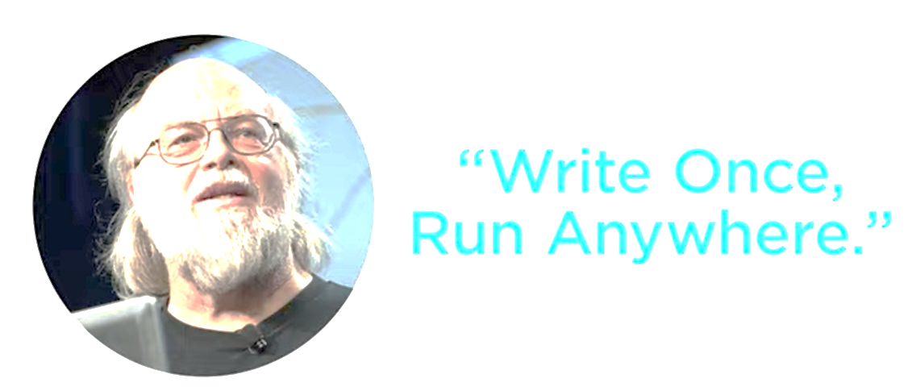
Motivation behind developing Java

Slide 38
What is Java?
It is an object-oriented language developed by Sun in the mid 1990s.
Original language called Oak
Intended for embedded systems
Based on C and C++
Now, popularly used in console, GUI, web and mobile applications
Sun describes it as
"A simple, object-oriented, distributed, interpreted, robust, secure, architecture neutral, portable, high-performance, multi-threaded and dynamic language."
Notes:
At that time , c++ was dominating the market and used for developing the software applications.
The need for developing Java was developing embedded system.
Runtime requirements for running c++ was very high.

Slide 39
What was the reason of creation?
Need a cross-platform language for multiple-device development.
C++ though object oriented and widely used was highly resource intensive.
Developed with the aim of “Write Once, Run Anywhere”.

Slide 40
What is Java? (cont)
Object-Oriented Programming Language
Designed to support Object-Oriented concepts
Platform
To execute java on your machine, you need java runtime environment (JVM)
JVM accept the byte code and executes the machine.
Distributed
Applications are constructed using objects. Objects can be distributed in multiple locations within a network environment.
Extensive integration with TCP/IP
Interpreted
Java compiles to byte-code (not machine code). Byte code is interpreted.
Most Java versions after 1.2 include a JIT (Just-In-Time) compiler which compiles byte code to machine code.
Notes:
machine code is a set of instructions in machine language or binary that can be directly executed by the CPU while the bytecode is an intermediate code generated from compiling a source code which can be executed by a virtual machine.

Slide 41
What is Java? (cont)
Robust
Memory management is done automatically
Exception handling support
Secure
All Java code subject to security model.
JVM verify that byte code and ensure that it is not performing any unsafe action.
No pointer so access to arbitrary memory location is restricted.
Architecture-Neutral/Portable
Compiled Java (byte code) will run on any platform which has a Java Virtual Machine
The Java Virtual Machine is available for almost all platforms...
Even mainframes.
Notes:
2) Byte code and absence of pointer support makes the java a secure language.
though there are refference variables in java which act in a similar ways like pointer that is holding the address of an object for example consider class A { } class B { A a= new A(); } here 'a' is a refference variable which stores the address of the object A and the address is not revealed to the user or any other because if u try to access the address of 'a' it returns a fully qualified address i.e. packagename.classname@some hexadecimal value by doing so the security is preserved and illegal access is avoided.
Most of the pointer related manipulation is done implicitly by the JVM and only references are used by the program. This is in order to abstract the memory from the overall application program in order to keep it safe from corruption, insecure access, etc memory related problems.

Slide 42
What is Java? (cont)
Multi-Threaded
Processes contain multiple threads of execution.
Similar to multi-tasking but all threads share the same memory space.
Rich set of Libraries
The Java API is extensive.
The standard JDK comes with over 200 built-in packages containing Java APIs

Slide 43
Platform Independence. How does Java do it?
Java has been described as WORA (Write once, Run Anywhere)
Because Java source code is compiled to byte code and the byte code is interpreted, Java code can be executed anywhere an interpreter is available.
The "Interpreter" is call the Java Virtual Machine

Slide 44
The Java Virtual Machine.
Traditionally, source code had to be compiled for the target hardware and OS platform:
Windows
Compiler
i386 binary
Solaris
Compiler
Source.cpp
SPARC binary
Mac
Compiler
PPC binary

Slide 45
The Java Virtual Machine.
Java source files (.java) are compiled to Java bytecode (.class)
Bytecode is interpreted on the target platform within a Java Virtual Machine
i386 VM
Java
Compiler
Java
Bytecode
Source.class
SPARC VM
Source.java
PPC VM
Notes:
The OS does not understand the code without any translation layer. The JVM understands the code. You need to install the java run time (JRE) which runs the JVM on any machine you wish to run java code. This is due to that java is not "native" code like C or C++ instead something is needed to convert the instructions to machine code which the JVM does.

Slide 46
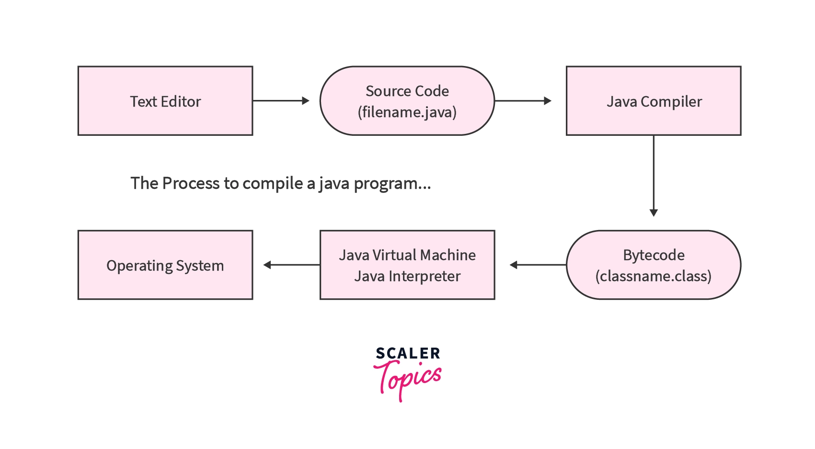

Slide 47
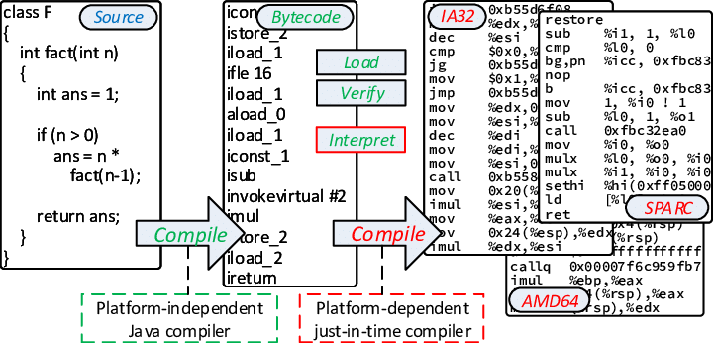

Slide 48
The Java Software Development Kit (SDK)
The Java SDK comes in three versions:
J2ME - Micro Edition (for handheld and portable devices)
J2SE - Standard Edition (PC development)
J2EE - Enterprise Edition (Distributed and Enterprise Computing)

Slide 49
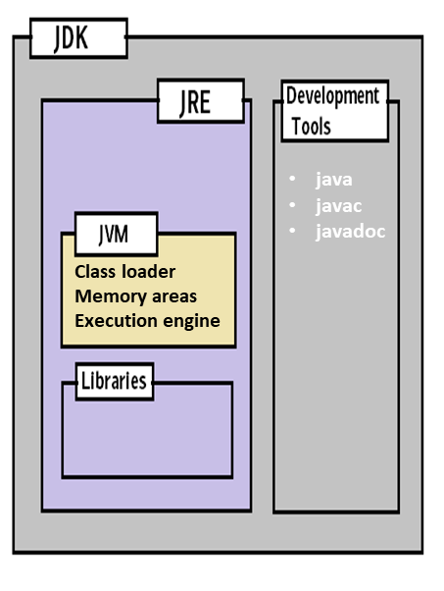
Common Terms
JDK – Java Development Kit (in short JDK) is Kit which provides the environment to develop and execute(run) the Java program. JDK is a kit(or package) which includes two things
Development Tools (to provide an environment to develop your java programs)
JRE (to execute your java program).
JRE – Java Runtime Environment (to say JRE) is an installation package which provides environment to only run(not develop) the java program(or application)onto your machine. JRE is only used by them who only wants to run the Java Programs i.e. end users of your system.
JVM – Java Virtual machine(JVM) is a very important part of both JDK and JRE because it is contained or inbuilt in both. Whatever Java program you run using JRE or JDK goes into JVM and JVM is responsible for executing the java program line by line hence it is also known as interpreter.

Slide 50
HelloWorld.java
Here is Java's "HelloWorld" implementation:
In the file, HelloWorld.java:
public class HelloWorld
{
public static void main(String[] args)
{
System.out.println("Hello World");
}
}
Notes:
Class is a keyword and used to declare a new class.

Slide 51
COURSE PROJECT
Should be MIS

Slide 52
SW Development Project: Deliverable 1
1 | APEX
2 | SYNOPSIS
3 | Chimera Soft
4 | LOGIX
5 | Envision Tech
6 | HEDZ
7 | Consumate Logiciels
8 | Logistics
9 | ATEK Inc
10 | Pi Sigma
11 | Erap Solutions
12 | Mantaq Solutions
13 | Design Minds
14 | Dream Technologies
15 | Logic All
16 | Synergy
17 | Solution Providers
18 | Ferocity Inc
19 | Cryph Tech
20 | COGILENT
Deliverable #1:
Deadline: (29th August)
COMPANY
Company Name (of your newly established company)
Company Logo
TEAM (3) Members
(Team) Manager
(Requirement) Analyst
Manager QA
Designer
Developers/SW Engineers

Slide 53
SW Development Project: Deliverable 2
Deliverable #2
Project Selection
Meeting with the client
Project Proposal
Present the idea of the project and what is aimed to achieve
Sections
Project Title
Scope
Objectives
Problem Statement and Description

Slide 54
Project Proposal Components
Title
Should be well defined Indicate the project aim and immediate solution its going to provide.
Scope
Defines the domain of the project. List any previous tools or work done in the same area. Also identify the level to which the project is going to be probed into in future.
Objective
Outline the major aims/goals that are aimed to be achieved through the project
Problem Statement and Description
Explain the major reason for choosing the project and the problem addressed by the project. Describe the problem in detail ( e.g. office automation mitigates manual work etc)
Should not be more than 2-3 paragraphs
Can also explain Feasibility.

Slide 55
SW Development Project: Deliverable 2
Deadline: 5th Sep, 2022
Project Title
Scope
Objectives
Problem Statement and Description
Project Proposal and other deliverables (to be explained later on by Course Instructors and LI’s)
Deliverable format : Found in course book, explained by course instructor OR explained in the assignment description.
If in doubt, YOUR responsibility to ask AHEAD of deadline, not ON or AFTER IT!

Slide 56
Home Work
Please revise OOP principles

Slide 57

Thanks

